Slide 1
Monoids and Sub-monoids
Transformation Monoids

Slide 2
Transformation Monoids
Transformation – functions or mapping from a set into itself
Cayley theorem - to construct a whole class of monoids whose elements are transformations; and “up to isomorphism”.

Slide 3
Transformation Monoids
Let S be any set and suppose that T={T_{α}} is a collection of mappings T_{α}:S→S which contains the identity transformation I_{s} and is closed with respect to composition of mapping, that is,
(T_{α}∈T )and (T_{β}∈T) →T_{α} οT_{β} ∈T
Then T is called a transformation monoid T=(T,ο ,I_{s}), when we take composition as the monoid operation; that is to say
(T_{α} ο T_{β})(s) = T_{β}(T_{α} (s))
Is taken as a the product T_{α} ο T_{β} in the monoid T.

Slide 4
Transformation Monoids
In order to be sure that T is indeed a monoid, one should verify the axioms
(T_{α} ο T_{β}) ο T_{γ} = T_{α} ο ( T_{β} ο T_{γ} )
(T_{α} ο I_{s} ) = (I_{s} ο T_{α} ) = T_{α}

Slide 5
Transformation Monoids
T_{α} ο (T_{β} ο T_{γ})(s) = ( T_{β} ο T_{γ} )(T_{α}(s))
= T_{γ} ( T_{β}(T_{α}(s))
= T_{γ} (( T_{α} ο T_{β} )(s))
= ( T_{α} ο T_{β} ) ο T_{γ}(s)
Which verifies the associativity axiom(1).
Axiom (2): Identity function

Slide 6
Transformation Monoids
Example:
  Consider eight transformation of the set S={0, 1, 2, 3}. We have I_{s} = T₁ and the collection
  T = {T₁,T₂,T₃,T₄,T₅,T₆,T₇,T₈}
  Is closed w.r.t functional composition, that is T₁ ο T₂ = T₅

Slide 7
Transformation Monoids
T₁
T₂
T₃
T₄
0
0
0
0
0
0
0
0
1
1
1
1
1
1
1
1
2
2
2
2
2
2
2
2
3
3
3
3
3
3
3
3
0
0
0
0
0
0
0
0
1
1
1
1
1
1
1
1
2
2
2
2
2
2
2
2
3
3
3
3
3
3
3
3
T₅
T₆
T₇
T₈

Slide 8
Transformation Monoids
T₃ ο T₂ = T₅
T₂ ο T₂ = T₁
T₂ ο T₃ = T₄
T₂ ο T₄ = T₃

Slide 9
Transformation Monoids
Theorem
  Every monoid is isomorphic to a transformation monoid.
Proof
  Let M = (M, . ,e) be any monoid and
  T_{M} = {T_{g}: g∈M} be the collection of transformation T_{g}:M → M given by
  T_{g}(x) = x.g (x∈M)
  We intend to show that the mapping g → T_{g} is a monoid isomorphism (M ~T_{M})

Slide 10
Transformation Monoids
Our mapping is surjective (onto), but also
  T_{g} = T_{h} => T_{g} (x) = T_{h}(x)
  => x.g = x.h
  => g = h
  Injective
e →T_{e} = I_{M} [T_{e}(x) = x.e = x = I_{M}(x)]
T_{gh} (x) = x(gh) = (xg)h=T_{h}(T_{g}(x))=(T_{g}οT_{h})(x)

Slide 11
Transformation Monoids
Consider the monoid M = (M, . ,e) as given below.
. | e | a | b | c
e | e | a | b | c
a | a | e | c | b
b | b | b | b | b
c | c | c | c | c

Slide 12
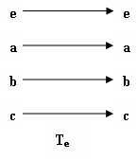
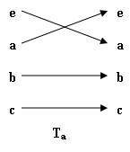
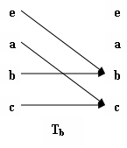
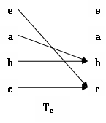
Transformation Monoids
For the monoid M=(M, . , e), the transformation T_{g} will be as follows.

